Slide 1
E-Commerce Application Architecture
By Vimal Panchal

Slide 2











Application Architecture
Global CDN
API Gateway
App Server
Oracle DB Instance
Cloud Front
Web Server
Availability Zone
Route 53
Elastic Load Balancing
Elastic Load Balancing
App Server
Images
Snapshot
Web Server
Availability Zone

Slide 3






Development Methodology
IDE
Developer
Generates Sonar Dashboards
Reports
Developer Workstation
Dev Server
Triggers Build
Source Control
Continuous Build
Dependencies & Artifact Repository
QA/Test Server
Retrieves Artifacts
Pre-Prod Server
UI Developer
Developer Workstation
S.N | Application | Artifact types
1 | Microservices | .jar, Docker Images
2 | UI | .js, .css, images, fonts
Prod Server

Slide 4
Tools & Configuration Segment
Program & Project Management Capabilities
Quality and Knowledge Management Capabilities
Configuration & Release Management Capabilities
Planning & Project Mgmt.
Quality Management
Version, Release & Artifact Mgmt.
JIRA
Sonar Server
Sonar Qube
GIT
GERRIT
Knowledge & Collaboration Mgmt.
Deployment
Resource & Collaboration Mgmt.
MS Share Point / JIRA
Jenkins
JIRA
Slack & Skype
Analysis & Design Capabilities
Build , Deployment & Test Capabilities
Build & Integration Enablement
Container Orchestration
Integration &
Automation Execution
Performance Test
Analysis Enablement
Design Enablement
Jenkins
Maven
Kubernates
JMeter
MS Office Suite
Open source tool
JUNIT
Software Development Capabilities
App Dynamics
MS Office Suite
Docker
SOAP UI
Microservices
Spring
Selenium
Hardware Capabilities
Server Deployment
AWS
Apache Web Server
Tomcat Application Server
DB

Slide 5
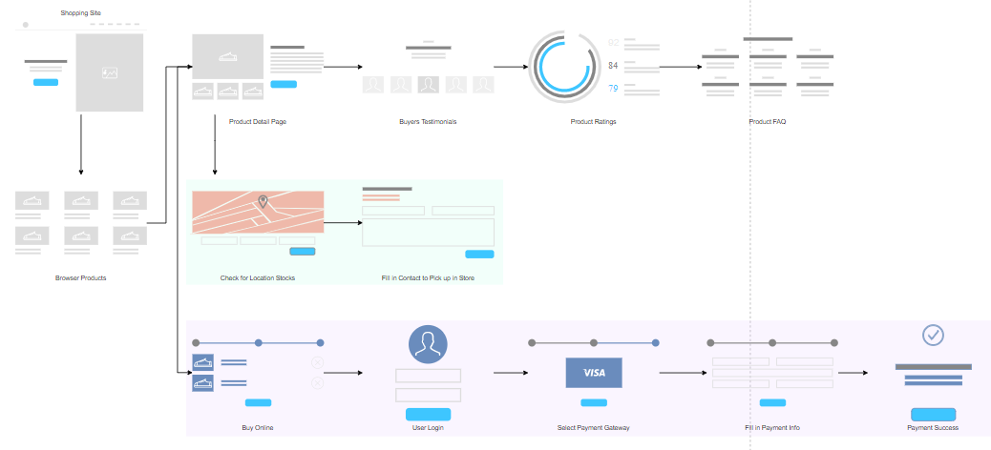
Flow Diagram

Slide 6
References
https://creately.com/app/?tempID=hp2eegde2&login_type=demo#
https://online.visual-paradigm.com/diagrams.jsp
https://aws.amazon.com/blogs/aws/three-new-aws-reference-architectures-for-e-commerce/
Thank & Regards,
Vimal Panchal

